Slide 1
CLIENT | SERVER
ClientHello Certificate* (1) ClientKeyExchange (2) CertificateVerify* [ChangeCipherSpec] (3) Finished Application Data | ServerHello Certificate* ServerKeyExchange*(1) CertificateRequest* ServerHelloDone [ChangeCipherSpec] Finished (3) Application Data
Server to client authentication (depending on the key exchange method). Client to server authentication MITM protection guarantee

Slide 2
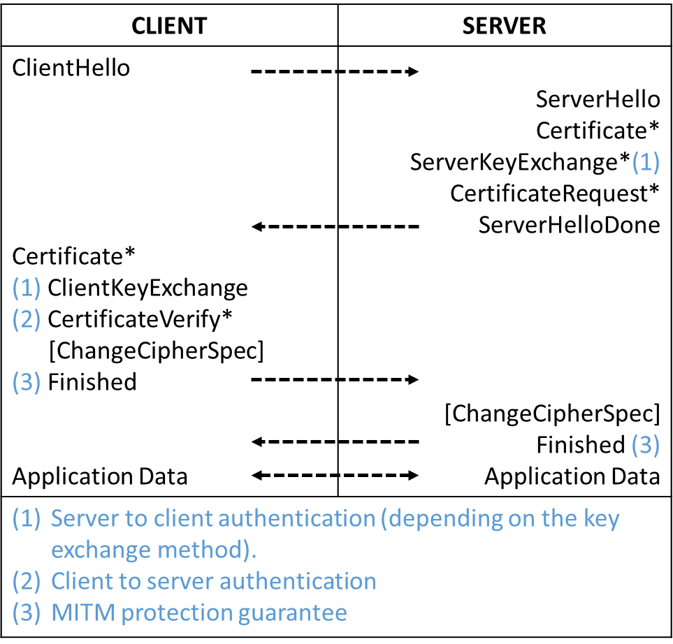

Slide 3
Asymm Auth?
PFS?
PFS?
1. ECDHE-PSK 2. DHE-PSK
1. ECDHE-RSA 2. DHE-RSA 3. ECDHE-ECDSA
1. RSA, RSA-PSK 2. ECDH-RSA 3. ECDH-ECDSA
1. PSK

